Slide 1
English - Vietnamese Neural Machine Translation
Phạm Văn Cường - 20194421
Nguyễn Tuấn Dũng - 20194427
Phạm Cát Vũ - 20194465

Slide 2
Table of contents
Overview
Preprocessing
Transformer model
Implementation
Data Augmentation
Experimental results

Slide 3
OVERVIEW

Slide 4
Overview
Task
Translating English sentences to Vietnamese sentences
Dataset
IWSLT 2015 dataset developed by Stanford NLP Group
Over 133,000 sentence pairs

Slide 5
PREPROCESSING

Slide 6
Preprocessing
Replace HTML characters
Tokenize the input sentences using 3 different methods:
Simple tokenization
Word segmentation
Byte pair encoding

Slide 7
Preprocessing - Simple tokenization
Simply split tokens by space.
Punctuations are also counted as tokens.
Utilize the NLTK Toolkit, for both languages.
Example:
“Bạn là ai?” => [“Bạn”, “là”, “ai”, “?”]

Slide 8
Preprocessing - Word segmentation
Vietnamese may contain multi-syllable words, for example “Việt Nam” should be treated as a single token.
Breaking those words up lose word’s meaning, and makes the vocabulary less diverse

Slide 9
Preprocessing - Word segmentation
We segment multi-syllable Vietnamese words using the underthesea framework.
Example: “Sinh viên A đi học muộn.” ⇒ [“Sinh viên” , “A”, “đi học”, “muộn”, “.”]
English sentences are tokenized in the usual way.

Slide 10
Preprocessing - Byte pair encoding (BPE)
Builds a token vocabulary and a merge table
Token vocabulary is initialized with the character vocab; merge table is empty
Each word transformed to a sequence of tokens plus a special end-of-word symbol
Example: “ate at”
Transformed sequence: “a t e /w a t /w”
Token vocabulary: {a, t, e, /w}

Slide 11
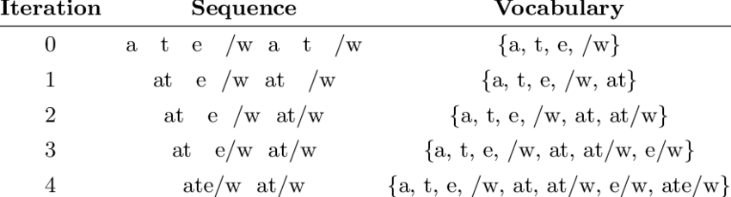
Preprocessing - Byte pair encoding (BPE) (Cont.)
Merges the most frequent pair into a new token
New token added to token vocabulary; merge operation added to merge table
Repeat the previous step until the desired token vocabulary size is reached
Apply merge in merge table according to priority
Repeat until no merge from the table is available.

Slide 12
Preprocessing - Byte pair encoding (BPE) (Cont.)
Motivation: ensures that in the vocabulary
common words: a single token
rare words: ≥ 2 subword tokens
which solve the issues faced by:
word-based tokenization (very large vocabulary size, large number of OOV tokens, and different meaning of very similar words)
character-based tokenization (very long sequences and less meaningful individual tokens)
Notes:
common words are represented in the vocabulary as a single token while the rare words are broken down into two or more subword tokens which solve the issues faced by:
word-based tokenization (very large vocabulary size, large number of OOV tokens, and different meaning of very similar words)
character-based tokenization (very long sequences and less meaningful individual tokens)

Slide 13
Preprocessing - Building vocabularies
Build vocabularies for both English and Vietnamese.
Convert all tokens to lowercase to limit vocabulary size
How do we represent capitalized words ?

Slide 14
Preprocessing - Building vocabularies
Build vocabularies for both English and Vietnamese.
Convert all tokens to lowercase to limit vocabulary size
How do we represent capitalized words ?
⇒ Add token <upper>: placed before uppercase words (human name for example).

Slide 15
Preprocessing - Building vocabularies
Build vocabularies for both English and Vietnamese.
Add special tokens:
<upper>: placed before uppercase words (human name for example).
<SOS>: start of sentence.
<EOS>: end of sentence.
<UNK>: out of vocabulary.
<PAD>: used for padding.
Truncate/pad sentences to the same length (120 in particular).

Slide 16
TRANSFORMER

Slide 17
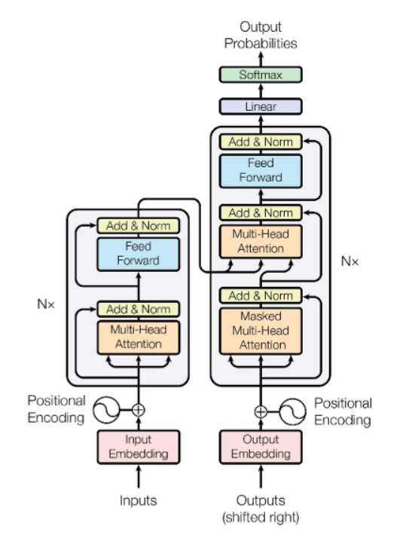
Transformer
Model overview
Consists of 4 components
Position encoding
Encoder
Decoder
Output layer

Slide 18
Transformer
Position encoding
Since the model requires no recurrence and no convolution, to extract useful information regarding the order of sequence, a Position encoding layer is required.
In the original paper, the author uses an established function for this layer. However, we instead use a Learned Position encoding as used in BERT, RoBERTa, and ViT

Slide 19
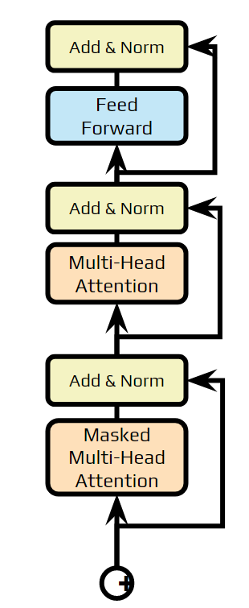
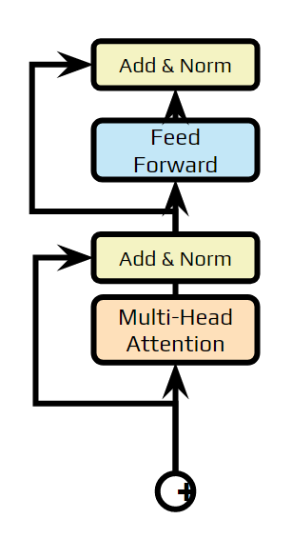
Transformer
Encoder
Decoder
Encoder
Encoder: N layers that contain 2 sub-layers with residual connection:
1 Multi-head self attention
1 linear layer
Decoder
N layers that contain 3 sub-layers with residual connection:
1 Masked Multihead self attention
1 multihead attention
1 linear layer

Slide 20
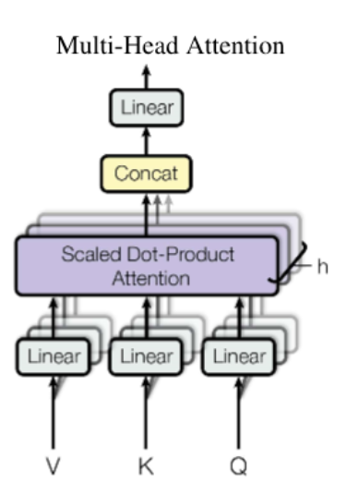

Transformer
Multihead attention
Attention mechanism: Scaled dot product attention
Very similar to Dot-product Attention, except for the scaling factor
Project keys, values and queries to h different learned projections in order to utilize multiple attention heads.
Later research shows that each attention head learns a different way in which words correlate to each other

Slide 21
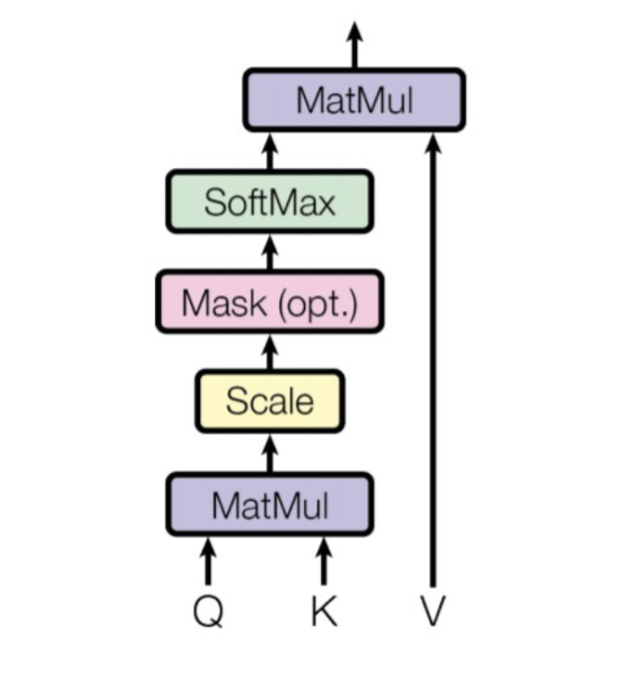

Transformer - Scaled dot product attention
An input embedding is transformed into 3 distinct vectors Q, K, V.
The dot product is divided by the square root of their dimensionality to make the variance 1.
Idea borrowed from information retrieval systems, where a queries are matches against keys then the results are used to retrieve the values.

Slide 22
IMPLEMENTATION

Slide 23
Implementation
The architecture used: Transformer:
3 Encoder and Decoder layers
8 Attention heads
Embedding dimension: 512
The models are trained with batch size 64, the learning rate and epochs will be discussed later.
Optimizer: Adam optimizer
𝛽₁ = 0.9, 𝛽₂ = 0.999 and 𝜀 = 1e-08.
Learning rate scheduler: Cosine scheduler with Warm-up.
The model evaluates the training loss and the evaluation loss on the Dev set every 250 steps, and the model’s current state is saved if the evaluation loss achieves the best performance.

Slide 24
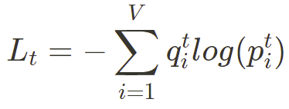



Implementation
Beam search with k = 5
Loss function: Cross Entropy with label smoothing
Where:
: The vocabulary size
: output distribution
: ground truth distribution

Slide 25

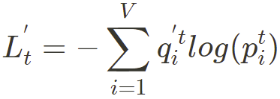
Implementation
To prevent overfitting on the hard 0-1 label distribution, Label Smoothing softens the distribution via interpolation between 𝒒 and a uniform distribution:
The loss function thus becomes:
Where 𝛂 is a hyperparameter set to a small value. We choose 𝛂=0.1 in our implementation.

Slide 26
DATA AUGMENTATION

Slide 27
Back Translation
Dataset
EVBNews (1000 word-aligned parallel news articles)
FPT Open Speech Dataset (26k Vietnamese sentences)
Merge to end up with 65k Vietnamese sentences
Techniques
Use a trained VI-EN Translation model to generate English predictions on monolingual data
Model
T5 Transformer from NLP HUST, HuggingFace
Vietnamese Monolingual data
VI-EN Model
English corpus

Slide 28
English - French back translation
65k English sentences
Dataset
65k English sentences from original corpus
Techniques
Translate these sentences to French
Then translate these French sentences back to English
Models
2 pre-trained Marian transformer model developed by the NLP group at The University of Helsinki
1 for EN – FR, 1 for FR - EN
EN – FR model
French sentences
FR – EN model
English sentences

Slide 29
Contractions
nsubj
Dataset
Original dataset
Idea
Contracting auxiliary verbs transforms the sentence without changing the meaning.
Expansion may create misinterpretation.
Contraction techniques
Use dependency parser to check for the dependency tag of nouns which is used to help deciding whether to contract auxiliary verbs.
Use regular expression (regex) for contracting “not”.
aux
advmod
They
are
driving
fast
PRON
VERB
VERB
ADV
Contraction
They’re driving fast

Slide 30
Synonym Replacement
English
Randomly choose a word in the sentence for replacement
He trips over the floor
Word type: Noun
Synonym: Autumn

Slide 31
Synonym Replacement
English
Randomly choose a word in the sentence for replacement
Get synonym candidates from wordnet
tumble
fall
vacation
He trips over the floor
Word type: Noun
Synonym: Autumn

Slide 32
Synonym Replacement
English
Randomly choose a word in the sentence for replacement
Get synonym candidates from wordnet
Only choose words with the same word type (Noun, Verb, Adj..)
Verb
Verb
Noun
tumble
fall
vacation
He trips over the floor
Verb
type: Noun
Synonym: Autumn

Slide 33
Synonym Replacement
English
Randomly choose a word in the sentence for replacement
Get synonym candidates from wordnet
Only choose words with the same word type (Noun, Verb, Adj..)
Verb
Verb
Noun
tumble
fall
vacation
He trips over the floor
Verb
type: Noun
Synonym: Autumn

Slide 34
Synonym Replacement
English
Randomly choose a word in the sentence for replacement
Get synonym candidates from wordnet
Only choose words with the same word type (Noun, Verb, Adj..)
tumble
fall
He trips over the floor
type: Noun
Synonym: Autumn

Slide 35
Synonym Replacement
English
Randomly choose a word in the sentence for replacement
Get synonym candidates from wordnet
Only choose words with the same word type (Noun, Verb, Adj..)
Choose candidate with highest word2vec cosine similarity
0.6
0.4
tumble
fall
He trips over the floor
type: Noun
Synonym: Autumn

Slide 36
Synonym Replacement
English
Randomly choose a word in the sentence for replacement
Get synonym candidates from wordnet
Only choose words with the same word type (Noun, Verb, Adj..)
Choose candidate with highest word2vec cosine similarity
tumble
He trips over the floor
type: Noun
Synonym: Autumn

Slide 37
Synonym Replacement
English
Randomly choose a word in the sentence for replacement
Get synonym candidates from wordnet
Only choose words with the same word type (Noun, Verb, Adj..)
Choose candidate with highest word2vec cosine similarity
Transform synonym to correct form
tumbles
He trips over the floor
type: Noun
Synonym: Autumn

Slide 38
Synonym Replacement
Vietnamese
Replace the desired word with <MASK> token and pass it to PhoBERT
Then PhoBERT will give us a list of possible candidates that we can use to replace the original word
Compare cosine similarities of candidates to original word
Candidate: Rơi, lộn, đẩy, bay
Tôi bị ngã xuống vực sâu

Slide 39
EXPERIMENTAL RESULTS

Slide 40
Methods
Data
IWSLT 2015 dataset developed by Stanford NLP Group
Metrics
BLEU Score (cased and uncased)
Hyperparameters:
learning rate: 5e-4
epochs: 15
Dataset | Sentences
Train | 133.317
Dev | 1.553
Test | 1.268

Slide 41
Experiment 1: Tokenization
Tokenization technique | BLEU (uncased) | BLEU (cased)
Simple tokenization | 25.19 | 24.39
Word Segmentation | 25.83 | 24.69
BPE | 25.56 | 24.79

Slide 42
Methods
Dataset
IWSLT 2015 dataset + Augmented data of each method
Metrics
BLEU Score (cased and uncased)
Hyperparameters:
learning rate: 0.001
epochs: 20
Dataset | Sentences
Train | 133.317 + 65000(*)
Dev | 1.553
Test | 1.268
(*): One of the method is unable to generate 65000 sentences pair

Slide 43
Experiment 2: Data Augmentation
Augmentation technique | BLEU (uncased) | BLEU (cased) | Able to generate 65k pairs?
None (Word Segmentation) | 25.83 | 24.69 | -
Synonym replacement | 27.56 | 26.39 | Yes
Back Translation | 29.01 | 27.69 | Yes
English - French Back Translation | 27.53 | 26.34 | Yes
Contractions | 26.84 | 25.71 | No (46,466)

Slide 44
Pros & Cons
Technique | Pros | Cons
Synonym replacement | Only requires mono-lingual data Can be used for both high and low-resource language | Occasional semantic change Unnaturalness
Back translation | Utilize huge mono-lingual dataset | Translations' quality depends on that of original data
English - French Back Translation | Great open source pretrained translation models | Longest augmentation time (2 way translation) Good pre-trained models might not be available for low-resource languages
Contractions | Fastest augmentation time Preserve meaning | Limited augmentation capacity Only work on English

Slide 45
Conclusions
Word segmentation and BPE all improves simple tokenization performance
Augmentation increase models’ performance, especially back translation

